Slide 1

Feasibility of Tissue-Specific Gene Expression as a Predictor of Subject Age:
An Examination of Raw Expression Counts as a Method of Determining the Age of a Subject
A. Toloczko
L. Schoen

Slide 2
Overview:
Motivation
Methods
Results
Conclusions
Sources

Slide 3
Motivation
Understanding how gene expression changes with age is critical for understanding the biological processes that underlie human development, aging, and age-related diseases
Availability of large-scale databases of gene expression information have enabled more in-depth investigations into the relationship between gene activity and age
In this study, we examine how gene expression levels vary across individuals of different ages, attempting to identify tissue-specific genes that can be used to predict the age of a subject

Slide 4
Methods
Using RStudio, we loaded and merged raw gene expression data, subject phenotype data, and sample metadata into one large data frame.
The data frame was then used to preform regression analysis.
PCA was used to reduce dimensionality.
A K-Nearest Neighbors algorithm was used to make predictions about a subjects age.

Slide 5
Results
R² values tended to be between .1 and .3, with extremely small P-values
Small p-values suggest that the relationship between tissue-specific gene expression and age is statistically significant, despite modesty of explained variance
Tissues with higher R² values may have more stable expressions over time, or greater heterogeneity

Slide 6
Sample of Regression Statistics
High MSE an issue across most tissues
Genetic diversity among humans likely root cause of high MSE
Number of tissue samples available greatly impacts KNN prediction
Tissue | Linear Regression R² | Linear Regression P-value | KNN MSE
Adipose - Subcutaneous | 0.1287 | 1.79e-16 | 183.49
Adipose - Visceral (Omentum) | 0.2126 | 8.12e-25 | 127.93
Adrenal Gland | 0.0699 | 2.21e-02 | 221.96
Artery - Aorta | 0.2679 | 4.07e-26 | 118.48
Artery - Coronary | 0.1127 | 5.44e-04 | 151.92
Artery - Tibial | 0.2809 | 7.36e-43 | 140.38
Bladder | 0.2292 | 5.19e-02 | 193.71
Brain - Amygdala | 0.2384 | 8.10e-07 | 96.56
Brain - Anterior cingulate cortex (BA24) | 0.1194 | 1.37e-03 | 96.09
Brain - Caudate (basal ganglia) | 0.0918 | 1.67e-03 | 96.34
Brain - Cerebellar Hemisphere | 0.0672 | 4.31e-02 | 146.00
Brain - Cerebellum | 0.1464 | 1.14e-05 | 89.15
Brain - Cortex | 0.1663 | 6.65e-07 | 77.15
Brain - Frontal Cortex (BA9) | 0.0829 | 1.20e-02 | 77.23
Brain - Hippocampus | 0.1515 | 1.25e-05 | 76.00
Brain - Hypothalamus | 0.1721 | 8.68e-07 | 72.94

Slide 7
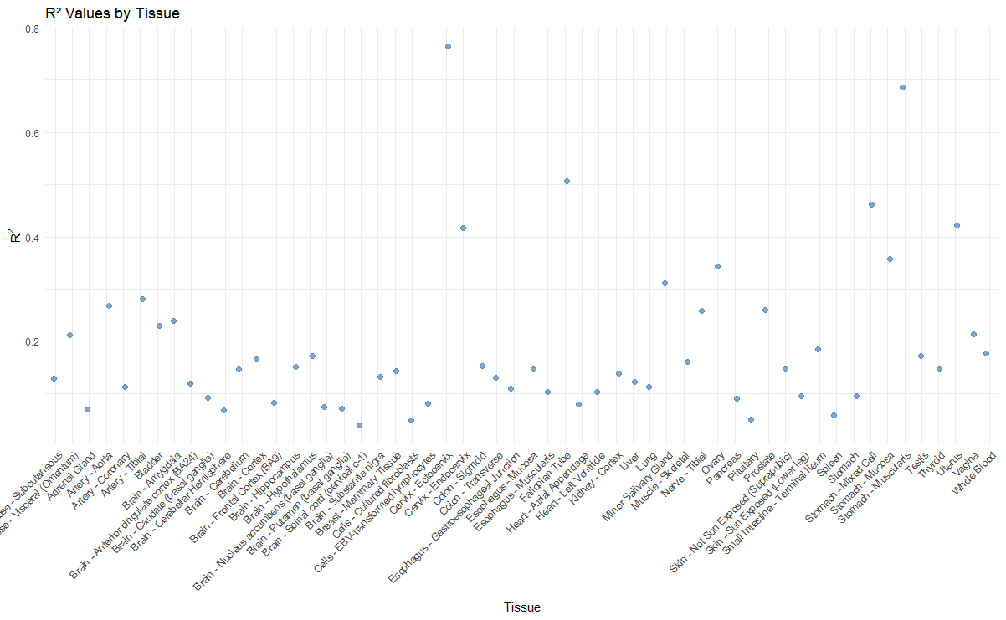

Slide 8
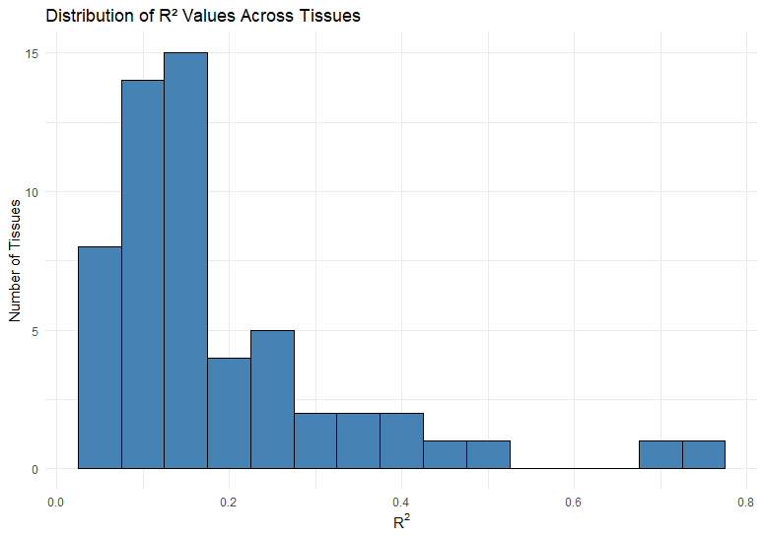
Distribution of R² Values
Most tissue expressions have modest R² values, indicating they explain moderate variance
Discrepancy between number of samples per tissue an issue in study reliability
Environmental impacts on gene expression, and genetic diversity may cause lack of reliability

Slide 9
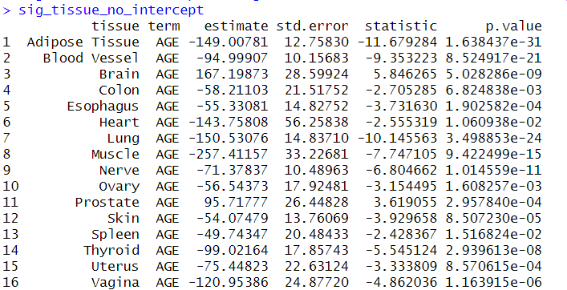
Conduction of Analysis
There were multiple ways that we conducted our analysis, the previous results being focused around each individual tissue and how age correlates with it
In this way we have all of the tissues grouped together under their overall type (i.e. Brain, Lung, etc.) and have different results for significant age correlations.

Slide 10
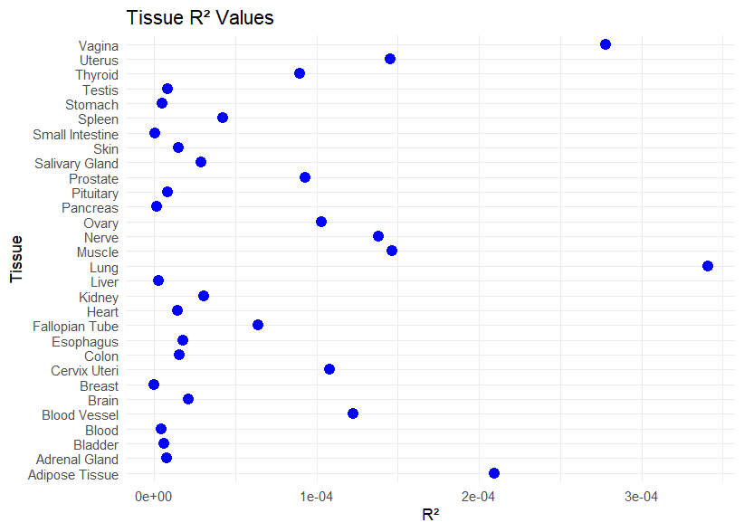
Distribution of R² Values
However this proves to make an ineffective model fit as show by the insignificant R² values.

Slide 11
KNN Prediction
Data split into training and testing sets, each randomly selected
Number of samples available per tissue presents an issue
Some tissues had few total samples, so there were few candidates for training or testing data
i.e. Stomach- Muscularis had only 26 total samples, while muscle- skeletal had 818 samples
Distribution of samples across age groups may impact prediction power
High susceptibility of gene expression to environmental impacts may impact accuracy of predictions

Slide 12
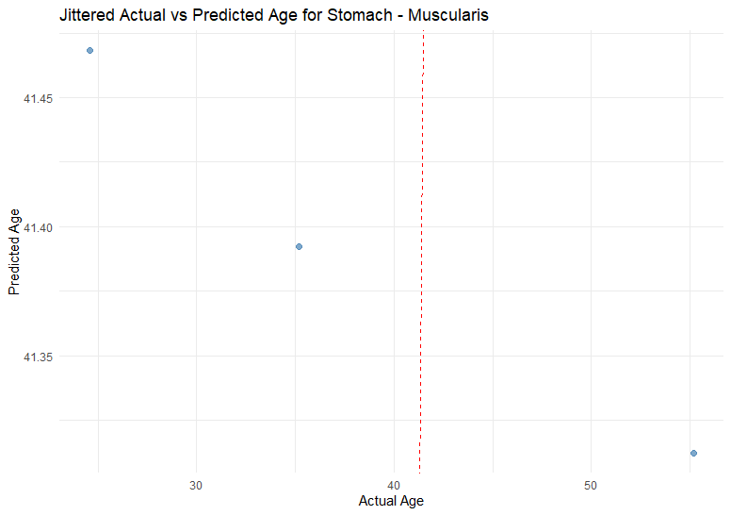
KNN Prediction: Stomach - Muscularis

Slide 13
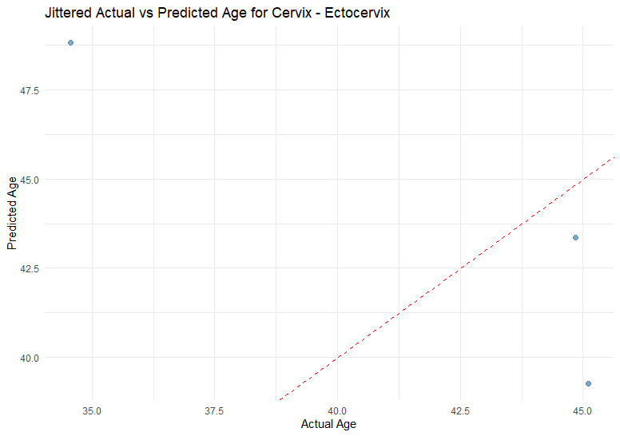
KNN Prediction: Cervix - Ectocervix

Slide 14
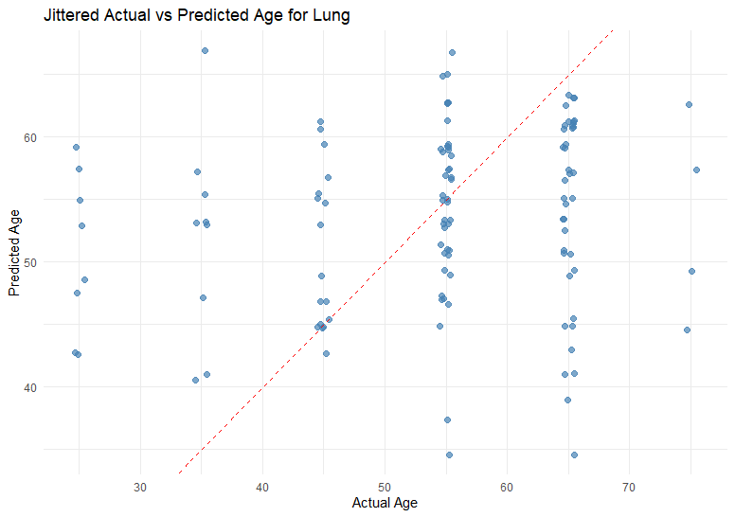
KNN Prediction: Lung

Slide 15
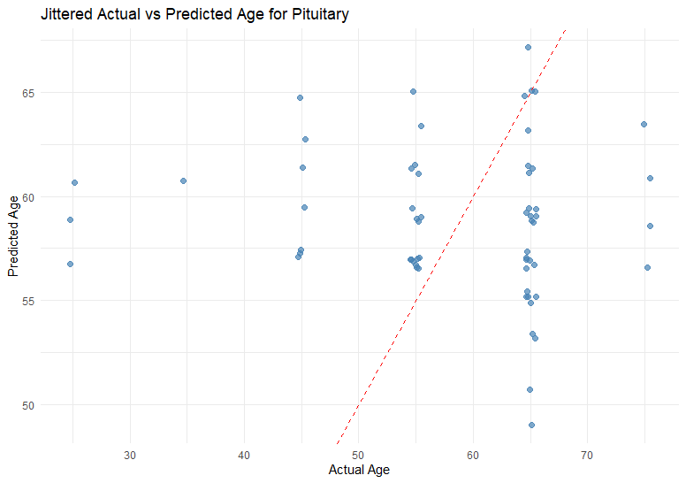
KNN Prediction: Pituitary

Slide 16
Conclusions
While there are genes that do correlate with age, generally gene expression data is not a useful predictor for subject age.
Moderate correlation statistics indicate that, while there is a moderate relationship, gene expression is not useful on its own.
Human genetics are highly diverse among individuals. While one individual may exhibit “normal” expression levels for their age group, another individual in the same age group may have wildly different expression levels.
Environmental factors can impact gene expression. The lack of control over exposure drastically reduces the feasibility of using gene expression as a predictor of subject age.

Slide 17
Sources
The data used for the analyses described in this presentation were obtained from: the GTEx Portal on 04/25/25 and/or dbGaP accession number phs000424.vN.pN on 04/25/2025.

